Slide 1
Project
Determine and examine factors that play a significant role in increasing the rate of heart attacks. Also, use the findings to create and predict a model .
Submitted by- Upamanyu Mondal

Slide 2
Project Task: Week 1
Importing, Understanding, and Inspecting Data:
Perform preliminary data inspection and report the findings as the structure of the data, missing values, duplicates, etc.
Based on the findings from the previous question remove duplicates (if any) and treat missing values using an appropriate strategy.
Get a preliminary statistical summary of the data. Explore the measures of central tendencies and the spread of the data overall.

Slide 3
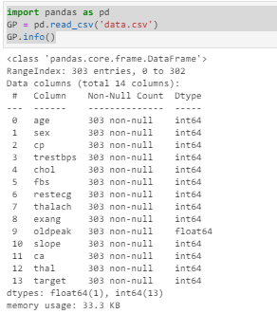
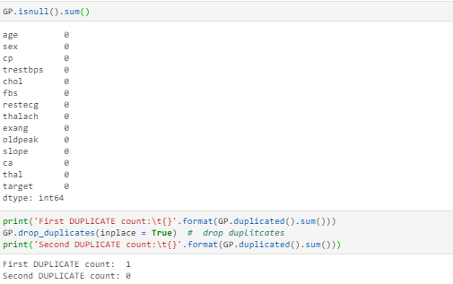
The file has 303 rows, with all having numeric values i.e. in integer or float format
No null values were seen…a duplicate value was present which was removed

Slide 4
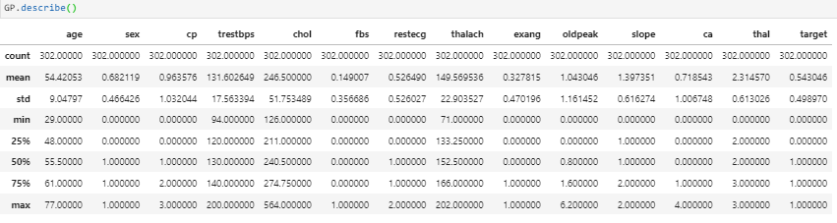
The statistical summary of the data. The mean values <1 in case of some values of the data is mainly because those values are in binary i.e 1 and 0

Slide 5
Project Task: Week 2
Performing EDA:
Identify the data variables which might be categorical in nature. Describe and explore these variables using appropriate tools e.g., count plot.
Study the occurrence of CVD across different ages.
Can we detect heart attack based on anomalies in resting blood pressure of the patient?
Study the composition of overall patients w.r.t . gender.

Slide 6
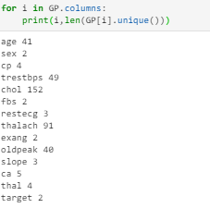
The categorical values are
sex
Chest pain type (cp)
fasting_blood_sugar (fbs)
resting_electrocardiographic (restecg)
exercise_induced_angina (exang)
slope_peak_exercise_ST (slope)
Number of major vessels colored by fluoroscopy(ca)
Thal (thalassemia)
target

Slide 7
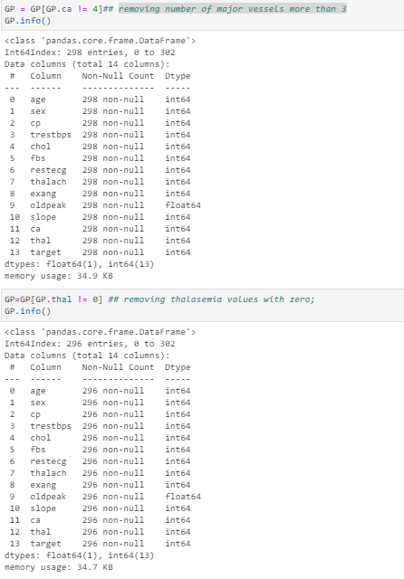
Removing number of major vessels more than 3
and
Removing thalassemia values with zero;

Slide 8
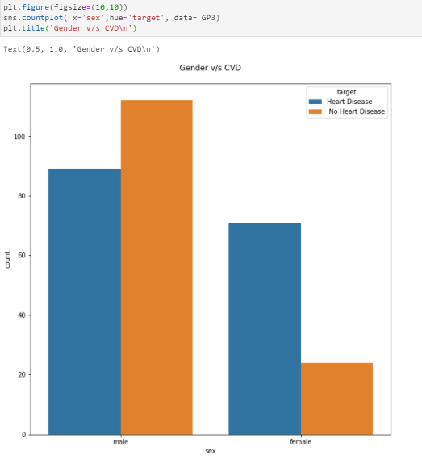
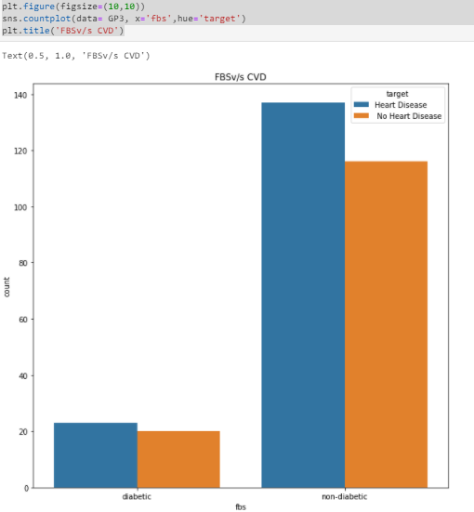
OBS- The number of male population with no heart disease is greater than female, the population of patients with heart disease is slightly higher for male.
OBS- The distribution is almost the same for patients with heart disease and patients without any heart disease. Therefore it is not a vey good indicator for heart disease. These days HBA1c values are more preferred to check for diabetic condition in heart disease.

Slide 9
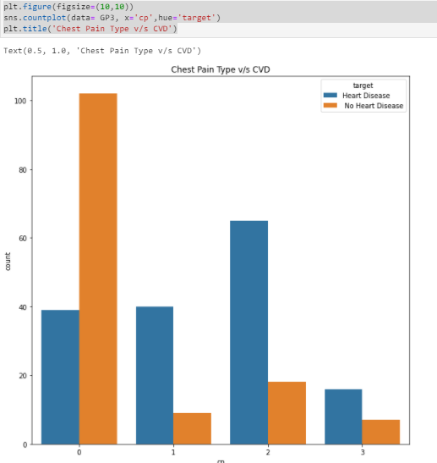
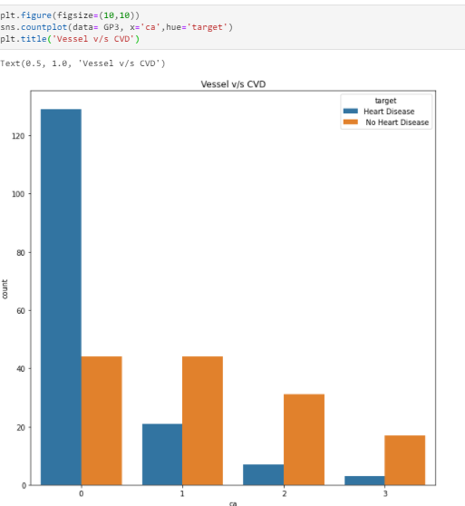
OBS- Persons with no chest pain are less prone to CVD, whereas type 2 or atypical angina has chance of CVD followed by type 1 or typical angina
OBS- Person with no major vessel colored are very much prone to CVD as it shows atherosclerosis or blockage in all the vessels

Slide 10
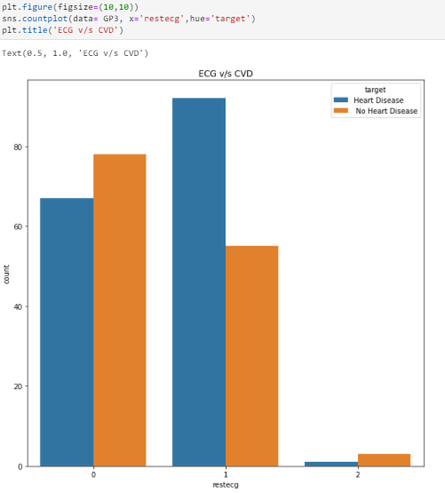
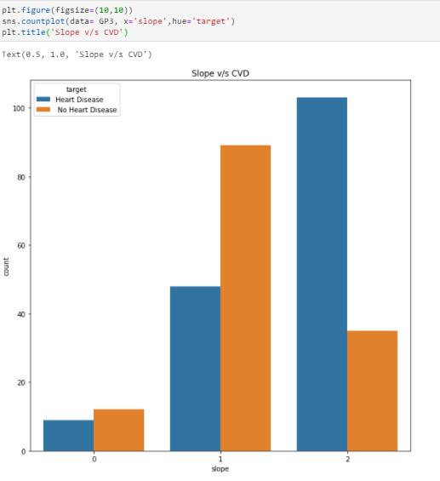
OBS- The healthy and unhealthy count is almost the same so not a good indicator. Though having ST-T wave abnormality (1) are more prone to heart disease.
OBS- patients having down-sloping (2) and flat (1) sloping are more prone to heart disease.

Slide 11
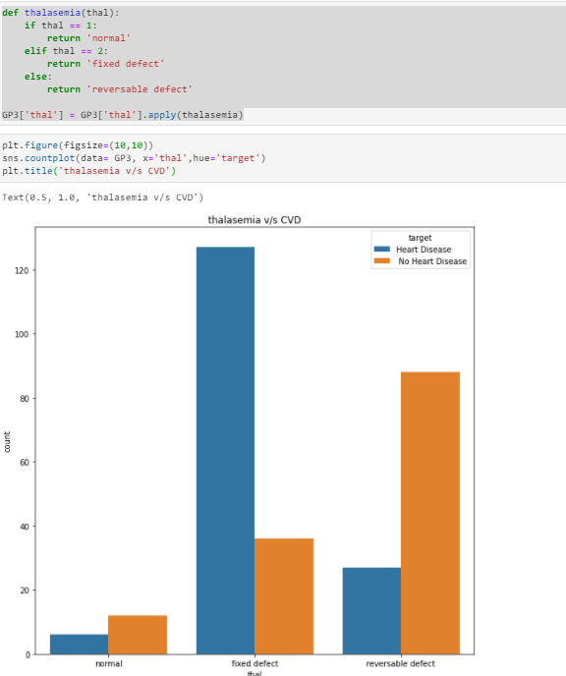
OBS- The patients with fixed defect have a significantly higher incidence of heart disease. Reversable defects can be easily treated so probability of it causing heart disease is less.

Slide 12
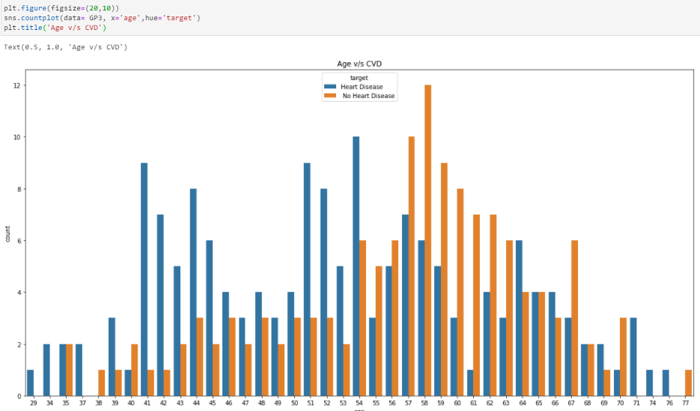
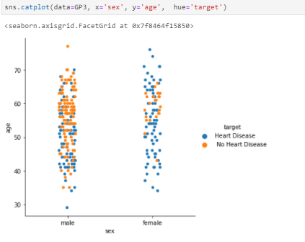
The count of patients with heart disease is more after 41 years.
The distribution of heart disease is more evident in females above the age of 40. In some males heart disease distribution is not very clear with age.

Slide 13
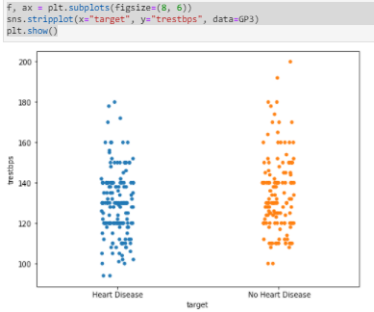
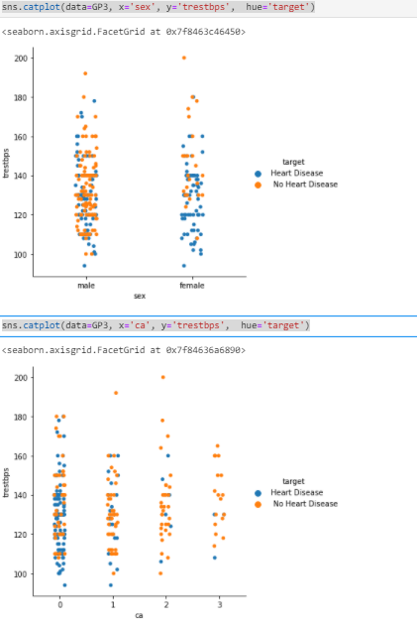
Can we detect heart attack based on anomalies in resting blood pressure of the patient?
Checking BP distribution alone does not give a clear idea as to how it is affecting heart disease
BP distribution in male and female do not give a clear indication.
But BP distribution with no blocked vessels(i.e. all 3 vessels colored with fluoroscopy) shows that a patient can have high BP but will not have heart disease. But patients all 3 blocked vessels ( i.e either 0 and 1 vessels colored by fluoroscopy) have higher risk of heart disease with BP greater than 120.

Slide 14
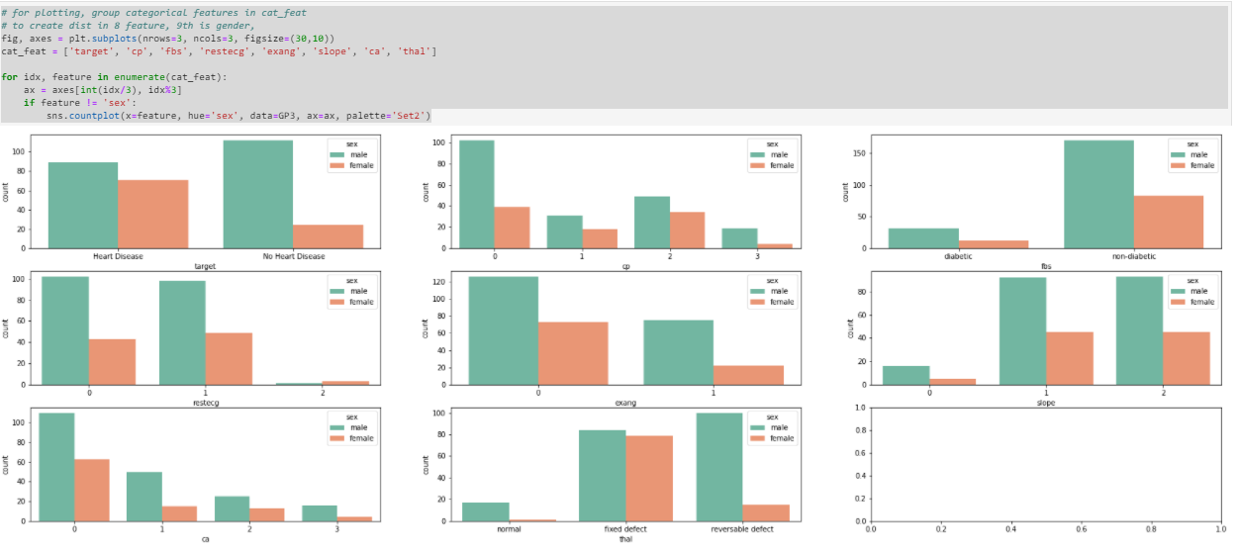
Studying the composition of overall patients with respect to gender
Distribution of categorical variables.

Slide 15
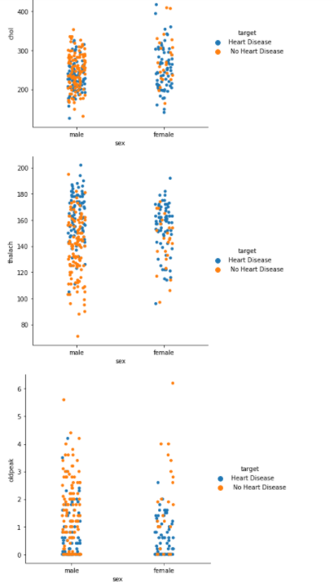
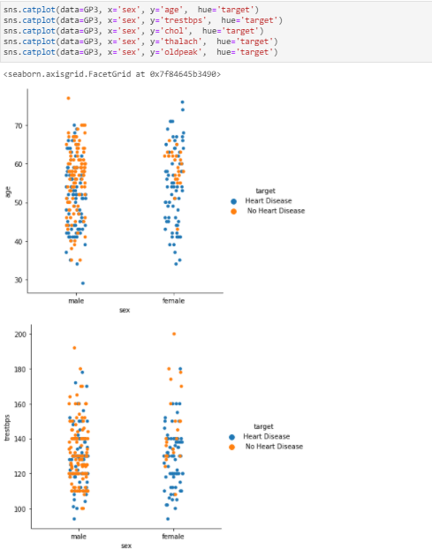
Distribution with respect to numeric variables i.e age, BP(tresbps), chol(cholesterol), max heart rate (thalach),
ST depression(oldpeak) with respect to gender

Slide 16
Project Task: Week 3
Performing EDA:
Describe the relationship between cholesterol levels and our target variable.
What can be concluded about the relationship between peak exercising and occurrence of heart attack?
Is thalassemia a major cause of CVD? How are the other factors determining the occurrence of CVD?
Use a pair plot to understand the relationship between all the given variables.
Perform logistic regression, predict the outcome for test data, and validate the results by using the confusion matrix.

Slide 17
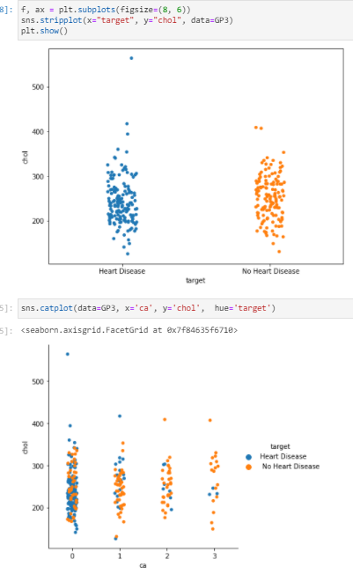
Only taking cholesterol value alone is not showing any good distribution.
But cholesterol distribution with no blocked vessels(i.e. all 3 vessels colored with fluoroscopy) shows that a patient can have high cholesterol but will not have heart disease. But patients with 2 or 3 blocked vessels ( i.e either 0 and 1 vessels colored by fluoroscopy) have higher risk of heart disease with high cholesterol.

Slide 18
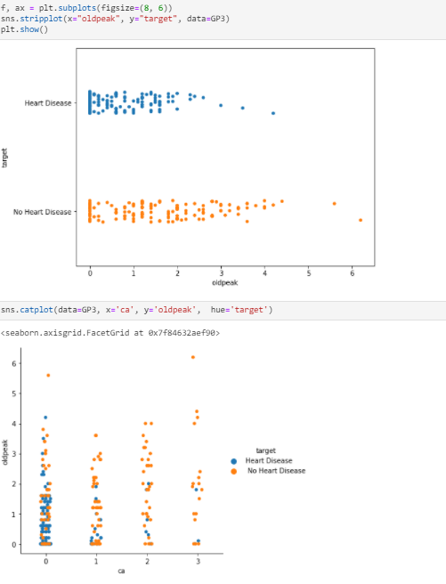
The observation is similar to BP and Cholesterol. The distribution with more number of blocked vessels i.e. less vessels colored by fluoroscopy shows person with old peak values greater than 1 is in risk of developing heart disease

Slide 19
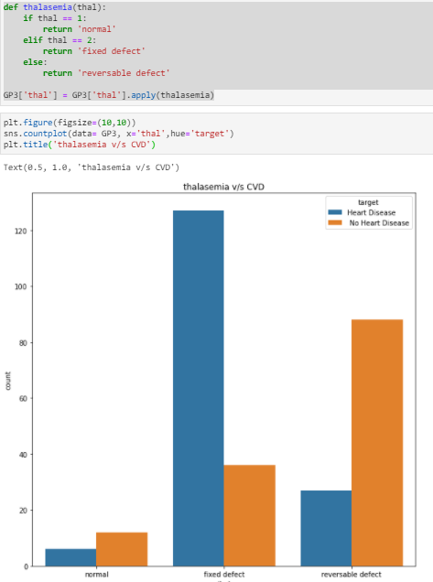
As we saw before, the reverse defect thalassemia cases have higher chances of heart disease. We will talk about how other factors are affecting once we go into correlation

Slide 20
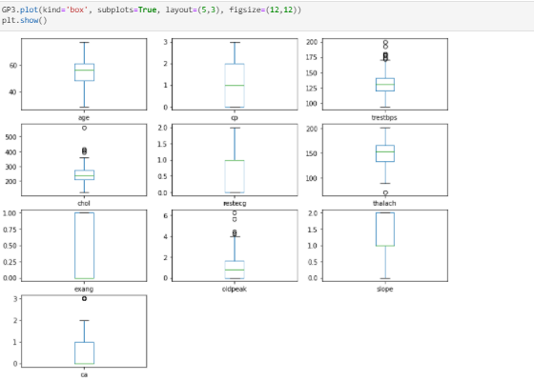
Outliers
outliers are seen for trestbps, cholesterol, oldpeak… Since removing this value will not be a good idea, as these higher values do have links with heart diseases according to literature. So we can scale the values and check for any difference in the pairplot.

Slide 21
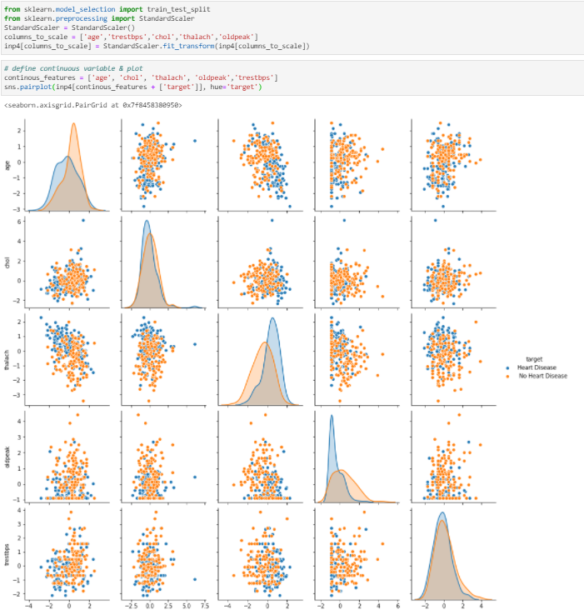
The pair-plot now shows the link of the numeric variables with heart disease. We will find it in details of the degree of correlation with a heat map

Slide 22
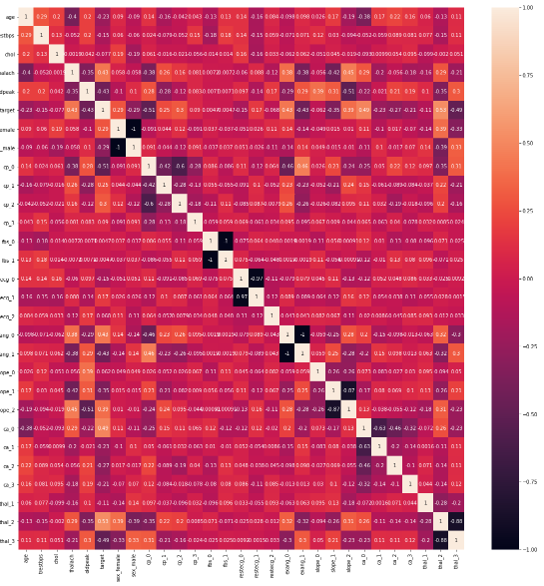
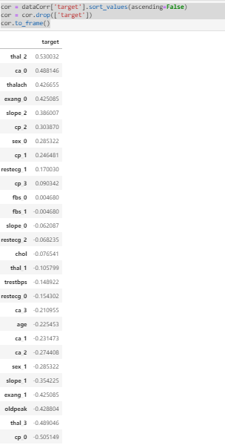

OBS-The maximum correlation of heart disease is with thalassemia fixed defect, heart vessels blockage(or no vessel colored by fluoroscopy and maximum heart rate achieved(thalach)

Slide 23
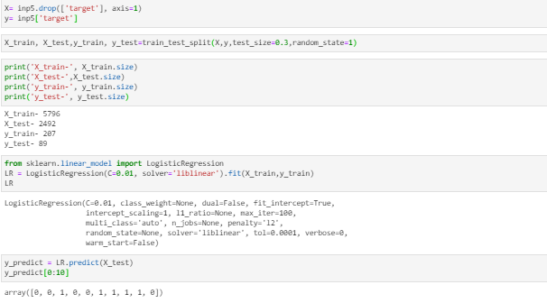
The data set was divided into train and test data set and logistic regression was perform

Slide 24
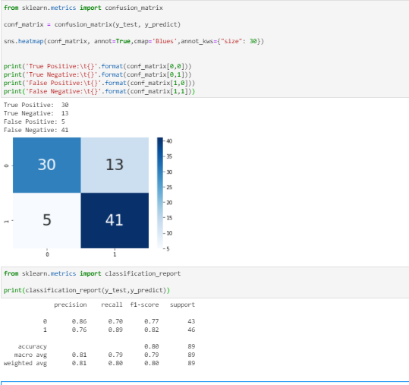
30 times– model predicted positive class correctly to be a positive class
13 times – model predicted negative class correctly to be the negative class
5 times– model predicted negative class incorrectly to be a positive class
41 times – model predicted positive class incorrectly to be the negative class

Slide 25
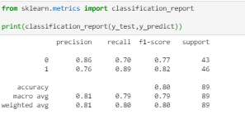
The model has a accuracy of 86 percent to predict no heart disease and 76 percent to predict a heart disease
The recall value is higher for predicting heart disease as 41 cases were missed out by the model (i.e False Negative)

Slide 26
Tableau Dashboard Link
https://public.tableau.com/app/profile/upa6018/viz/Heartdiseaseproject_16308539645150/Dashboard1?publish=yes
The dashboard is made with the variables having maximum correlation of heart disease thalassemia, heart vessels blockage(fluoroscopy) and maximum heart rate achieved(thalach)

